Slide 1
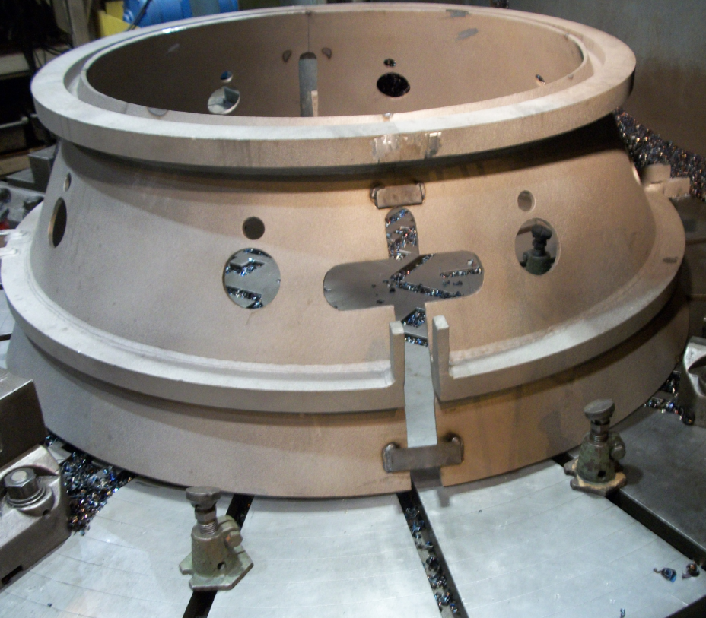
HS&E INCIDENT BULLETIN |  | 2nd Quarter 2013
Location: United States | Type of incident (Laceration, Struck by, Fracture)
Summary:
Operator was setting up Outer Diffuser on a boring mill while using bottle jacks with swivel heads to level the work piece. When adjusting the bottle jacks all of the swivel heads tilted the same direction causing the work piece to slide off of the bottle jacks striking the operators left ring & middle fingers.
Root Causes: | Actions Taken Thus Far: Next Steps
Training, Inadequate Ability to Recognize Hazards, Change Management, Housekeeping, |  | Re-evaluate & revise operator training plan, risk assessment’s and JHA’s, Eliminate the use of bottle jacks during set-ups by using standard and adjustable parallels, Add additional cribbing as a last resort.

